Slide 1

Building an iOS and Android App with Xamarin.Forms
Brent Edwards
Principal Lead Consultant
Level: Intermediate

Slide 2
Brent Edwards
BrentE@magenic.com
@brentledwards
http://www.brentedwards.net
https://github.com/brentedwards

Slide 3
What We Will Cover
What is Xamarin and Xamarin.Forms?
How does Xamarin.Forms work?
Xamarin.Forms Foundation
Custom Controls
MVVM

Slide 4
My Background
What I am
.NET Developer
Windows Developer
Native Android Developer
What I am not
Native iOS Developer
Xamarin Proper Developer

Slide 5
MyVote
[DEMO]

Slide 6
What is Xamarin?

Slide 7
What is Xamarin?
A way to build native apps for iOS and Android using C#
Built on the Mono framework
Still have to write different code for each platform’s UI

Slide 8
What is XAMARIN.FORMS?

Slide 9
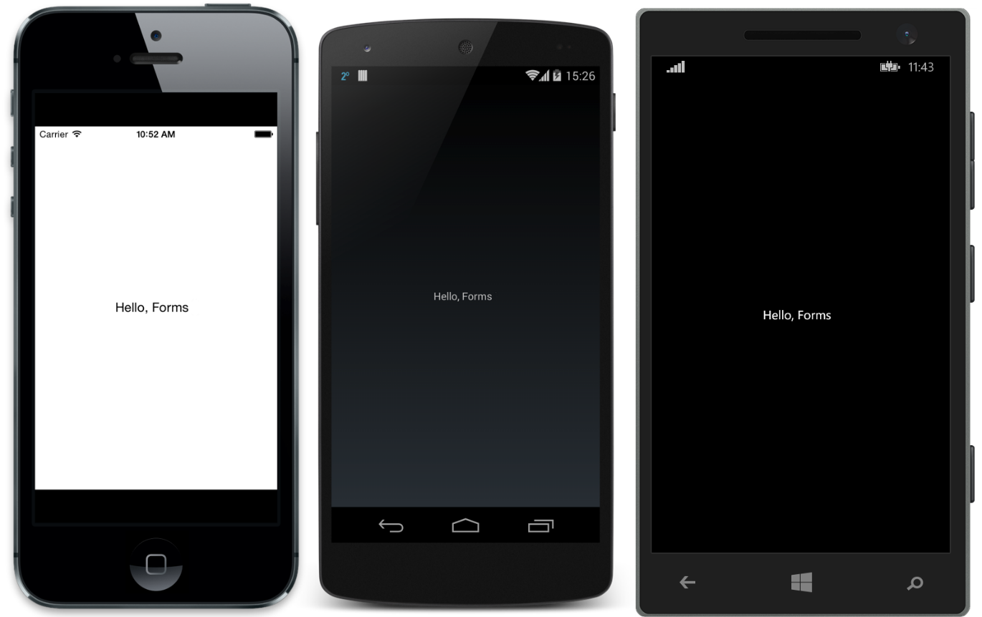
What is Xamarin.Forms?
Source: http://developer.xamarin.com/guides/cross-platform/xamarin-forms/introduction-to-xamarin-forms/

Slide 10
What is Xamarin.Forms?
A UI abstraction layer for Xamarin
Write apps once, run on:
iOS
Android
Windows Phone

Slide 11
What is Xamarin.Forms?
Suite of controls that map to native controls on each platform
Rendered with native look-and-feel
Framework for navigation and data binding

Slide 12
How does it work?
Xamarin.Forms Solution
Xamarin.Android Project
Native Android
Xamarin.iOS Project
Native iOS
Windows Phone Project
Native Windows Phone

Slide 13
Foundation

Slide 14
Foundation
4 Main Classes everything is built on
View
Page
Layout
Cell

Slide 15
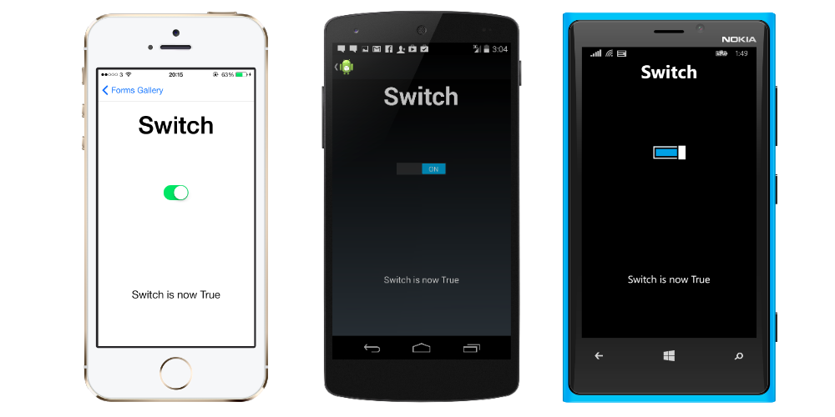
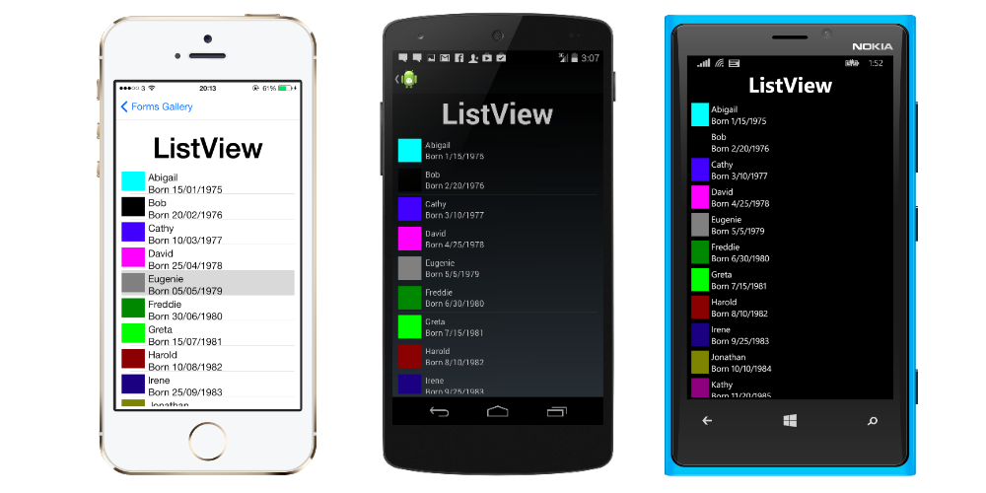
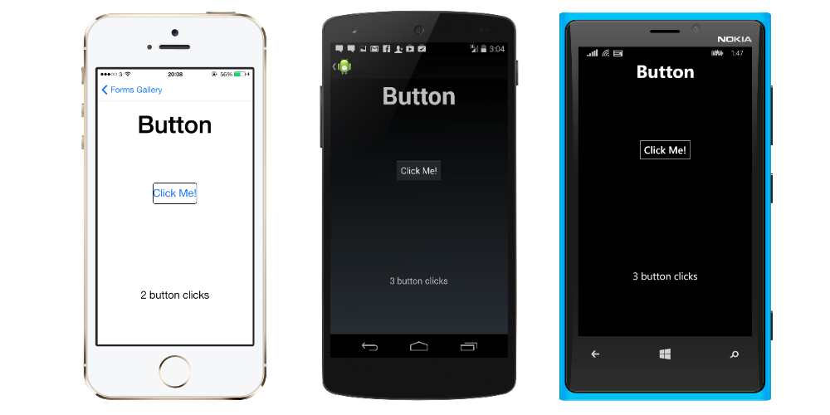
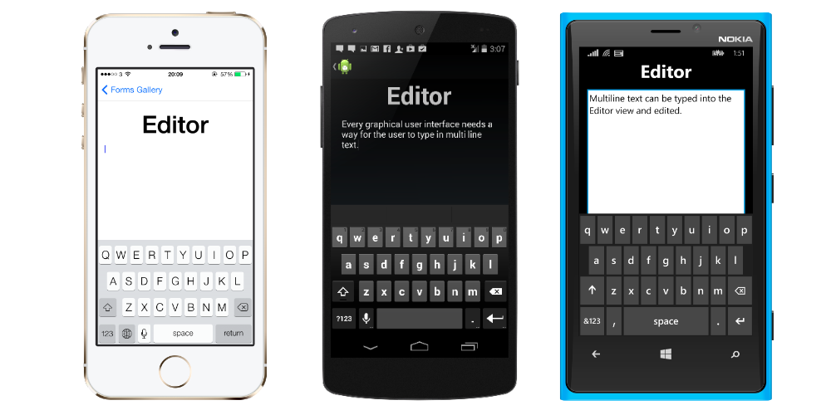
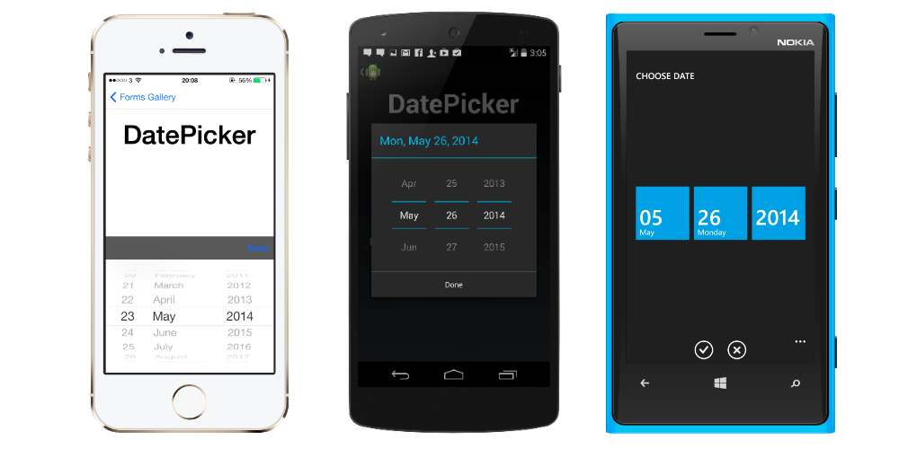
View
Typically called control or widget on native platforms
Examples:
Button
Editor
DatePicker
ListView
Switch

Slide 16
Page
Android
Activity
iOS
View Controller
Windows Phone
Page

Slide 17
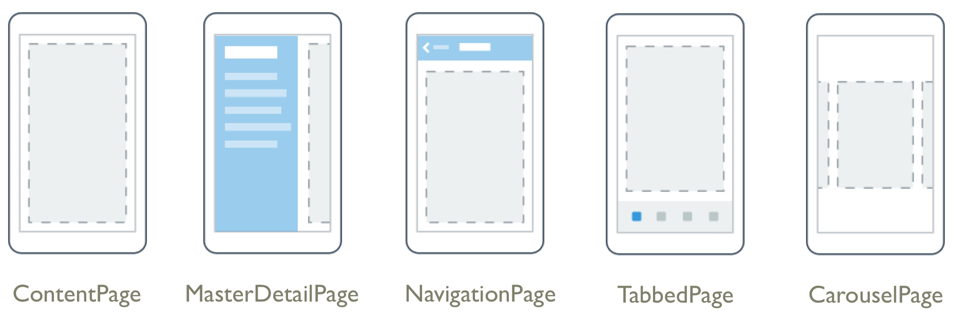
Page Examples
Source: http://developer.xamarin.com/guides/cross-platform/xamarin-forms/controls/pages/

Slide 18
Layout
Type of view used for… Layout!
Container for other Layouts or Views
2 Types
Managed
Unmanaged

Slide 19
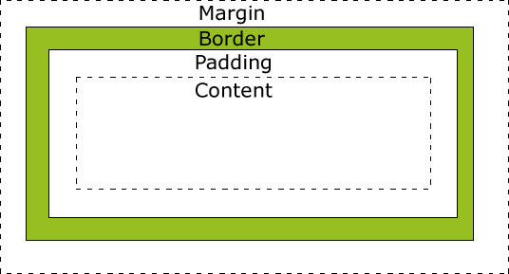
Managed Layout
Handles sizing and positioning child views
Follow CSS Box Model
Source: http://www.w3schools.com/css/css_boxmodel.asp

Slide 20
Unmanaged Layout
Does not handle sizing and positioning of child views
Developer sets this
Allows for precise positioning
Requires testing on many device sizes

Slide 21
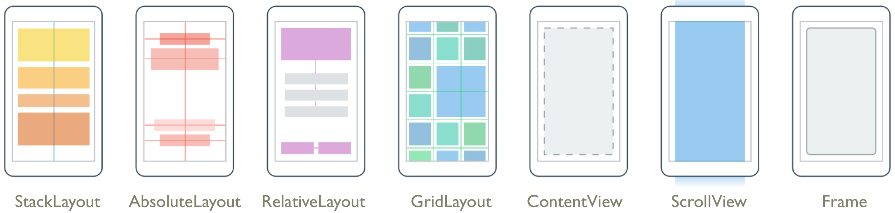
Layout Examples
Source: http://developer.xamarin.com/guides/cross-platform/xamarin-forms/controls/layouts/

Slide 22
Cell
Describes how items in a list or table should be drawn
Not a visual element
Like a DataTemplate in XAML
Designed for ListView and TableView

Slide 23
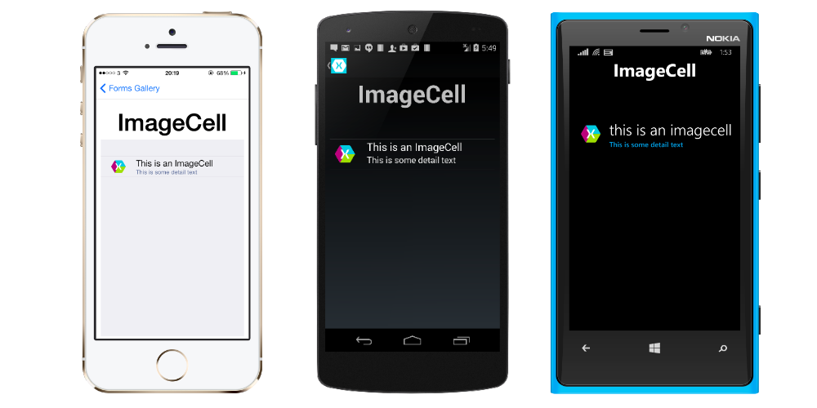



Cell
Examples:
EntryCell
SwitchCell
TextCell
ImageCell

Slide 24
Going Custom

Slide 25
Going Custom
What about custom controls?
Create a custom Renderer!
Renderers output native controls for each platform
All controls use Renderers

Slide 26
Custom Renderers
Can tweak existing controls
Can create completely new controls
Lots of power

Slide 27
Custom Renderers
How to do it
Create custom control
Can inherit from existing types
Create custom renderer for each platform
This dives into Xamarin proper
Bind them together with ExportRenderer attribute
Tells Xamarin that they are a pair

Slide 28
Custom Renderers
[DEMO]

Slide 29
Creating the UI

Slide 30
Creating the UI
C# vs XAML
No Visual Designer
No Intellisense for XAML in Visual Studio
Xamarin Studio Windows Doesn’t do iOS

Slide 31
Creating The UI
[DEMO]

Slide 32
MVVM
Model-View-ViewModel

Slide 33
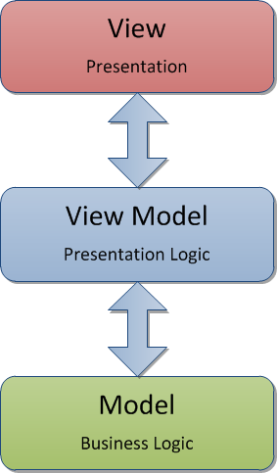
MVVM

Slide 34
Why is MVVM Cool?
Separates Presentation from Functionality
Promotes Testability
Works great with Data Binding
Easy collaboration with Designers
Makes it easy to change out the View layer!

Slide 35
MVVM with Xamarin.Forms
Xamarin.Forms supports data binding
Perfect for MVVM
Navigation and Messaging are also built in
Problem:
Xamarin.Forms doesn’t support WinRT
Solution:
Find an MVVM library that supports ALL the things

Slide 36
MVVM Cross

Slide 37
MVVM Cross
Why use it?
Supports Xamarin.iOS, Xamarin.Android, WinRT (Windows 8.1/Windows Phone 8.1)
Write view model layer once for all platforms

Slide 38
MVVM Cross
[DEMO]

Slide 39
Xamarin Forms: my thoughts

Slide 40
What We Covered
What is Xamarin and Xamarin.Forms?
How does Xamarin.Forms work?
Xamarin.Forms Foundation
Custom Controls
MVVM

Slide 41
Questions?

Slide 42
Brent Edwards
BrentE@magenic.com
@brentledwards
http://www.brentedwards.net
https://github.com/brentedwards

